Slide 1
The Transformer Architecture
CS 780/880 Natural Language Processing Lecture 18
Samuel Carton, University of New Hampshire

Slide 2
Last lecture
Sequence-to-sequence models
Main application: translation
Attention
Improves performance of sequence-to-sequence models
Improves interpretability of classifiers
Model saving/loading

Slide 3
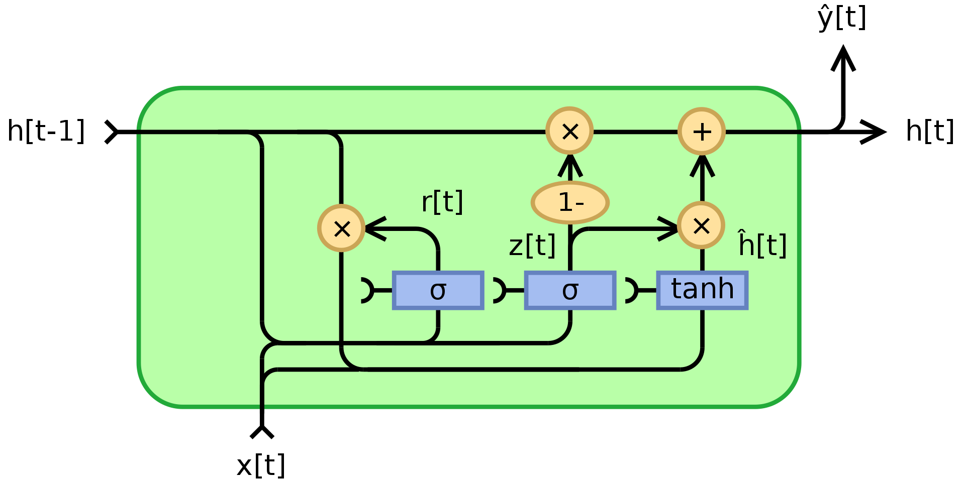
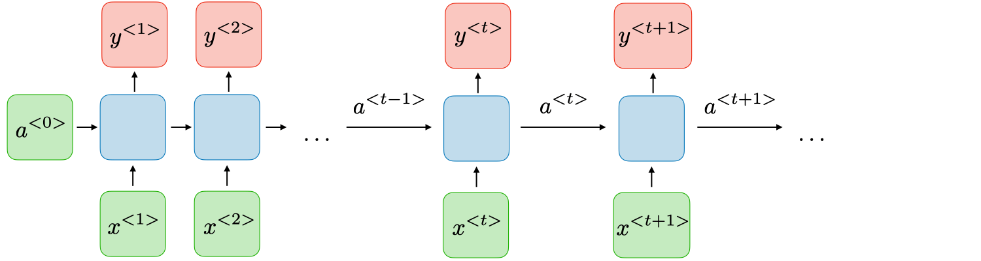
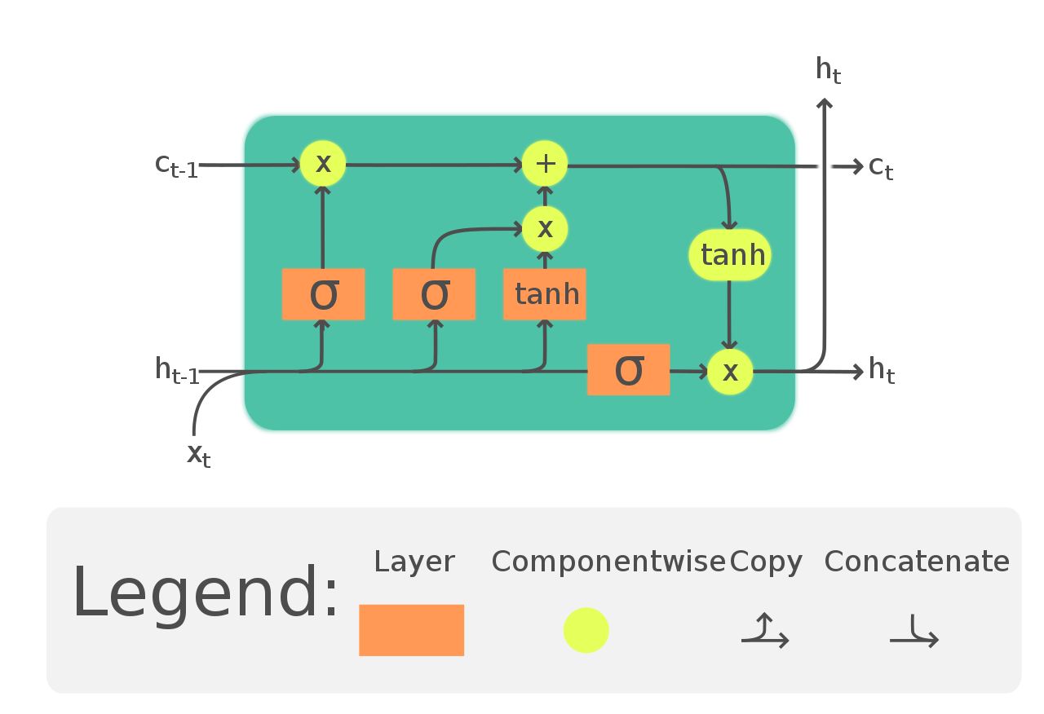
The main problem with RNNs
Because of vanishing gradients, it is hard for RNNs to learn to remember information in early timesteps that is needed for later timesteps (i.e. long-term dependencies)
This leads to catastrophic forgetting
RNNs are also not very parallelizable
GRU
https://en.wikipedia.org/wiki/Gated_recurrent_unit
LSTM
https://en.wikipedia.org/wiki/Long_short-term_memory

Slide 4
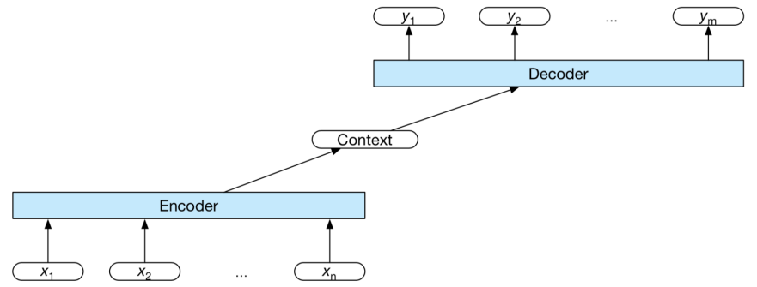
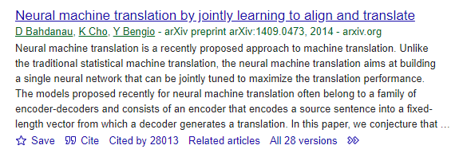

Solution: attention?
With sequence-to-sequence models, we discovered that attention is a valuable mechanism for augmenting the final context vector
So what if we just want to encode one sequence?

Slide 5
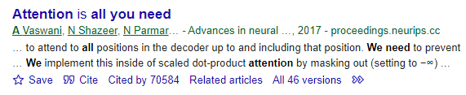

Transformers
The Transformer is a non-recurrent architecture that uses self-attention to represent relationships between words in the same sequence
As opposed to between words in the input and output sequence
Although, transformers are also be used in sequence-to-sequence models (and actually do both kinds of attention)
Invented in Attention is All You Need (Vaswani et al., 2017)

Slide 6
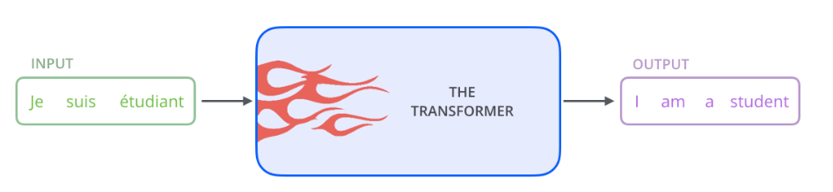
Transformers
Content for this lecture drawn largely from The Illustrated Transformer: https://jalammar.github.io/illustrated-transformer/
Super duper popular breakdown
Not a Medium article, but a good model of how influential these breakdowns can be (hint hint)

Slide 7
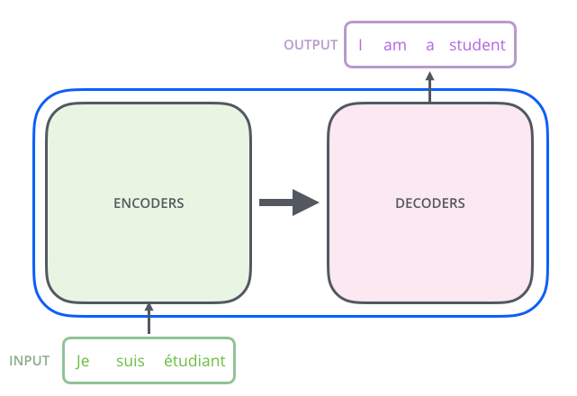
Encoder and decoder
The full transformer model includes an encoder (which encodes the text into a vector) and a decoder (which converts the encoded vector back into a text)

Slide 8
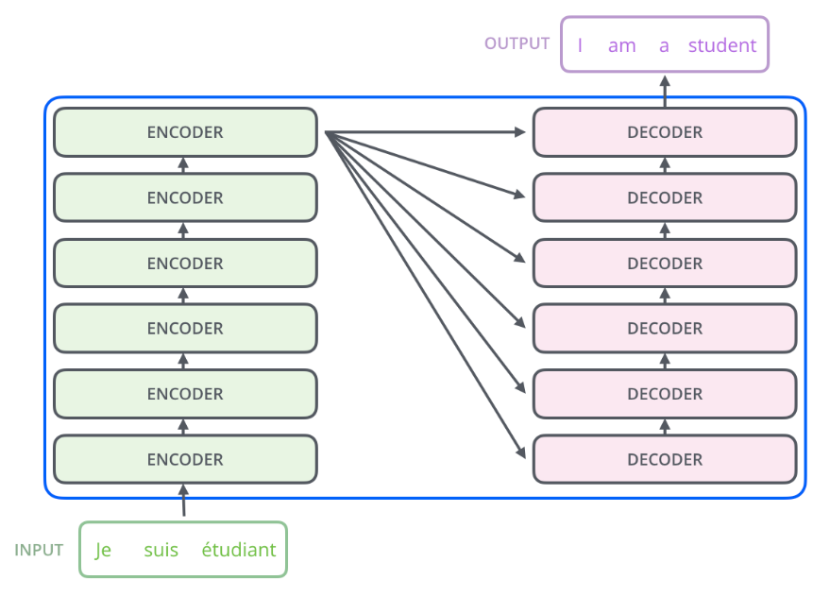
Encoder and decoder
Each component is actually a stack of repeated encoder or decoder layers

Slide 9
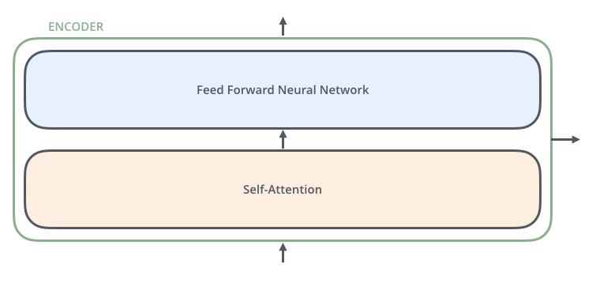
Encoder
The encoder consists of a “self-attention” layer, followed by a feedforward layer

Slide 10
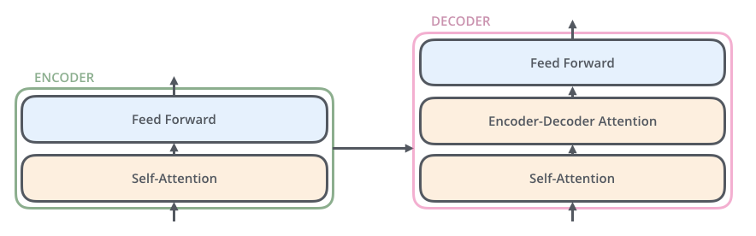
Decoder
And then the decoder consists of both of these elements, plus an additional layer that learns to attend to the output from the encoder.

Slide 11
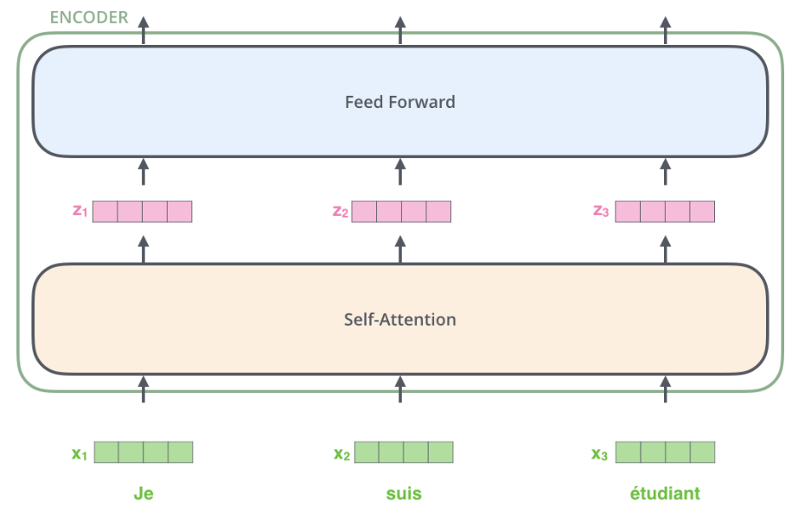
Encoder detail

Slide 12
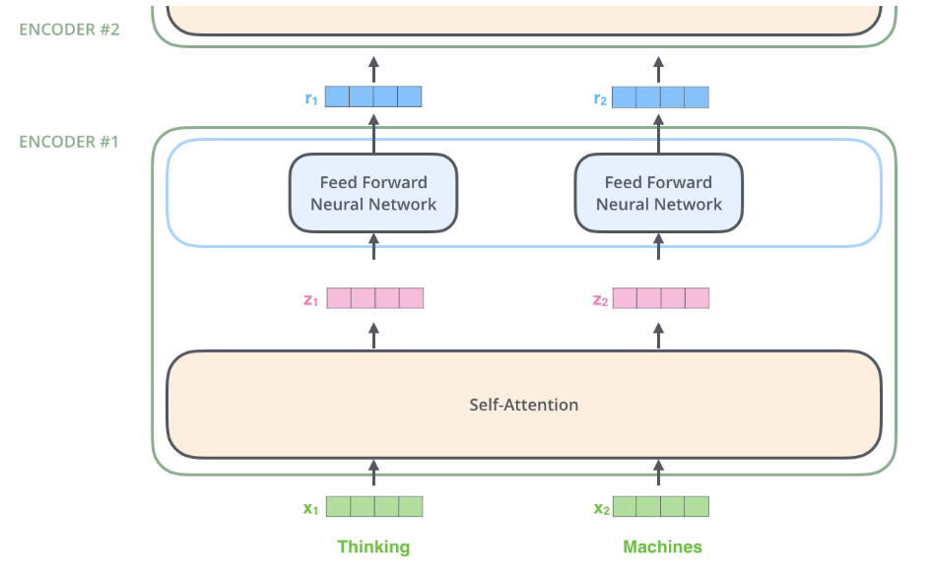
Encoder detail

Slide 13
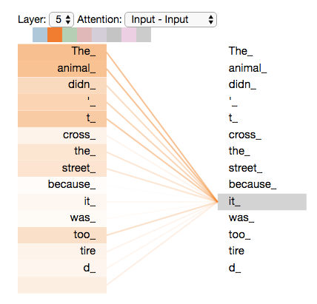
Self-attention
Basic idea: The model will learn an attention weight from each word w_{i} to each word w_{j}, representing how important w_{j} is for understanding the meaning of w_{j}
In this example, in order to understand “it”, we really need to understand “the” and “animal”, since that is what “it” is referring to

Slide 14
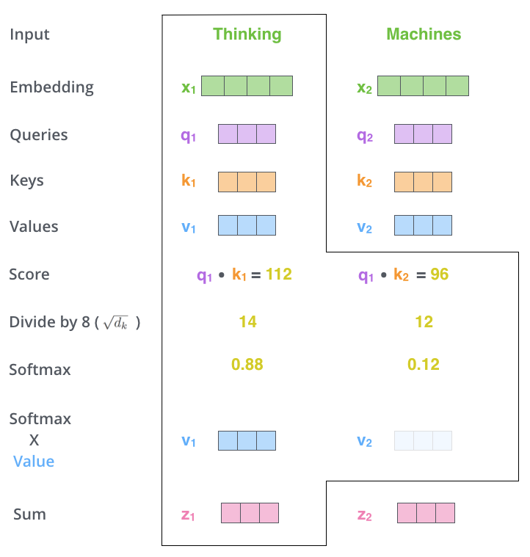
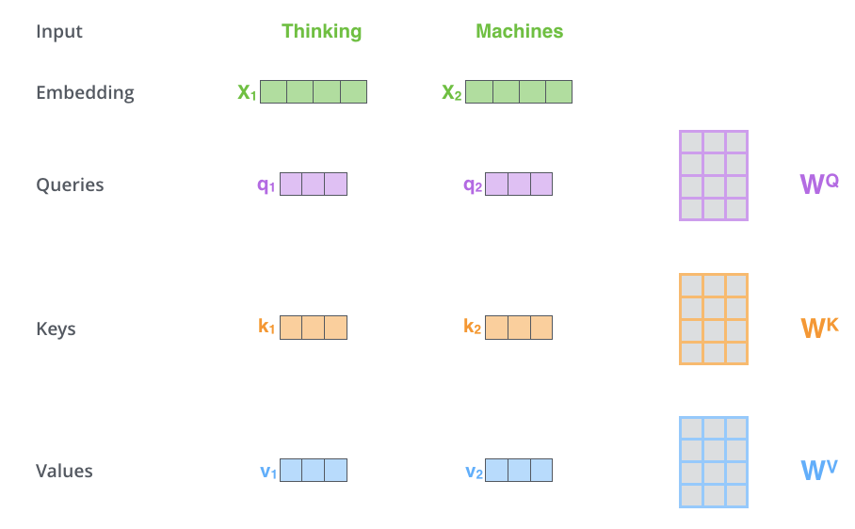
Self-attention detail

Slide 15

Self-attention detail

Slide 16
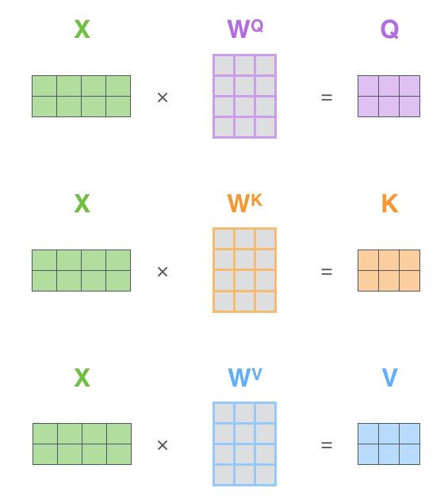
Self-attention detail

Slide 17

Self-attention detail

Slide 18
Self-attention detail

Slide 19
Self-attention detail

Slide 20

Self-attention detail

Slide 21
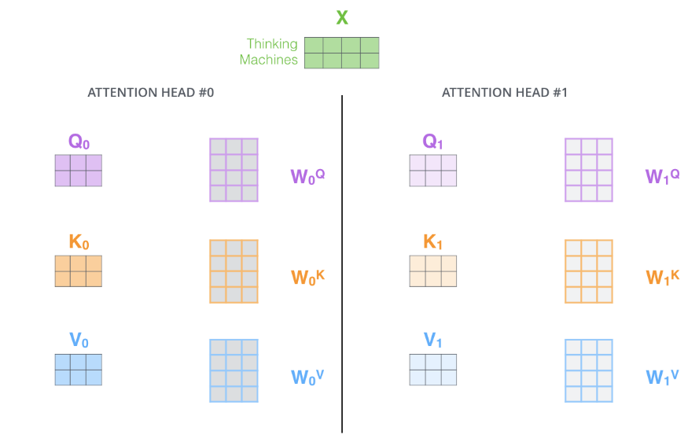
Multi-headed attention

Slide 22
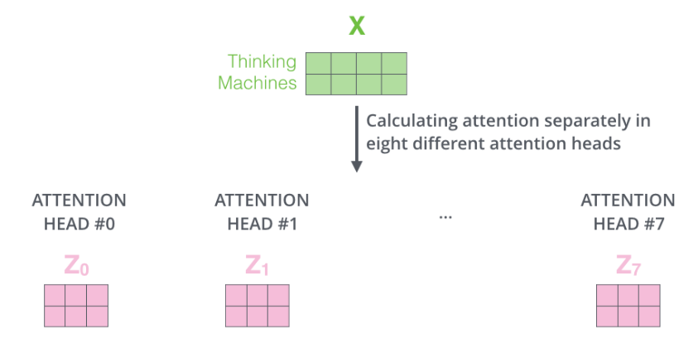
Multi-headed attention

Slide 23
Encoder detail

Slide 24
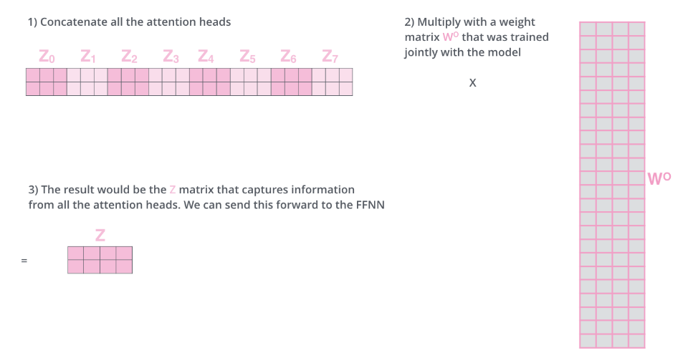
Multi-headed attention

Slide 25
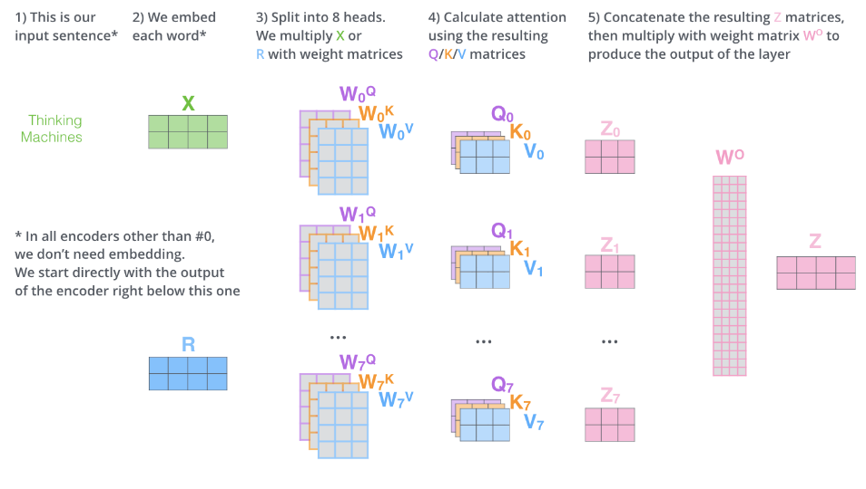
All self-attention steps

Slide 26
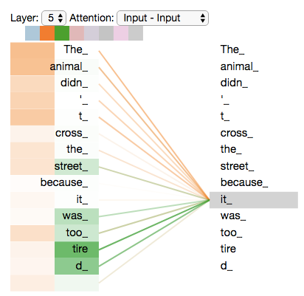
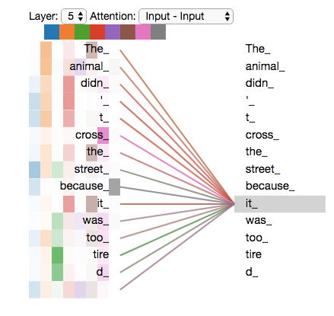
Multi-headed attention

Slide 27
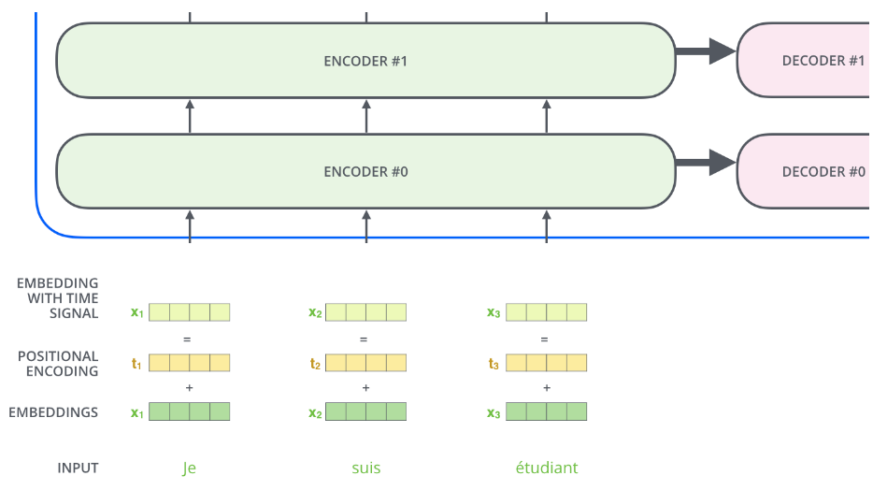
Positional embeddings

Slide 28
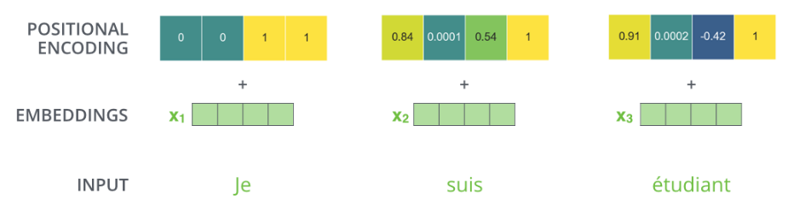
Positional embeddings

Slide 29
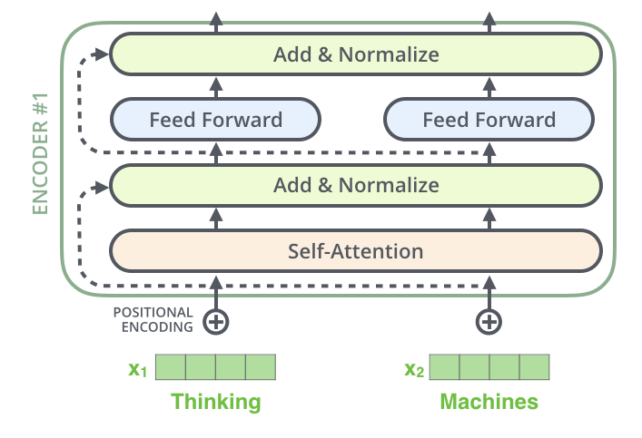
Residuals

Slide 30
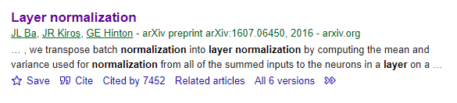
Layer normalization
Layer normalization is a training trick where you take the output from a neural net layer and statistically normalize it so that it has a mean value of 0 and a variance of 1
This turns out to improve training speed and consistency.
It’s kind of just one of those handy tricks that people have discovered to generally improve deep learning, similar to dropout and L2 regularization.

Slide 31
Residuals

Slide 32
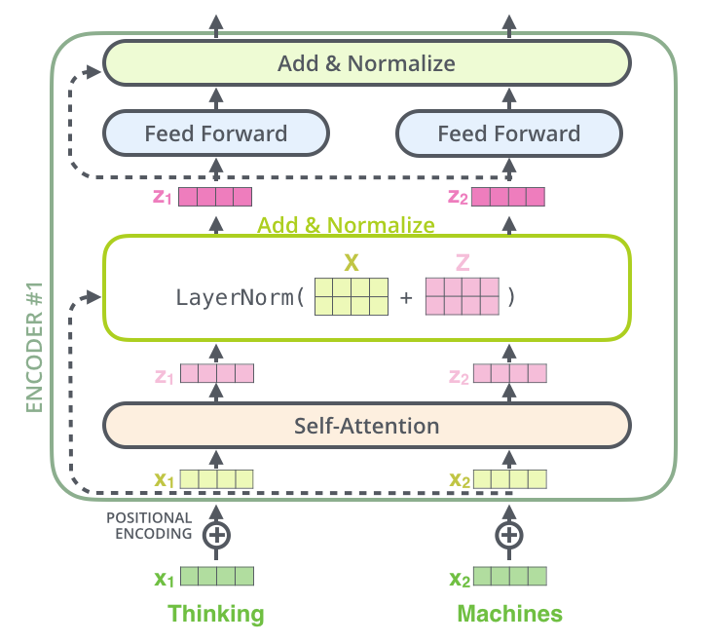
Residuals

Slide 33
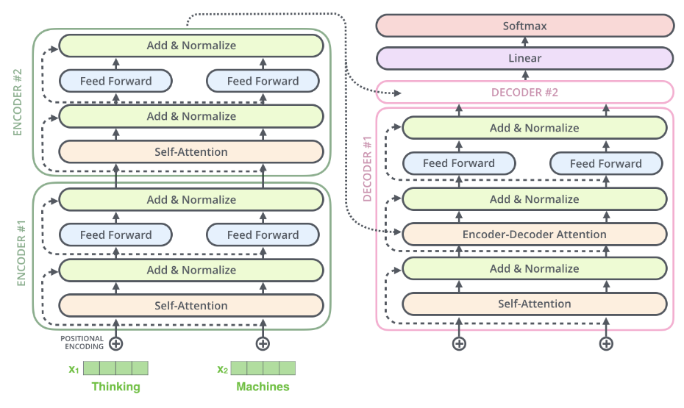
Encoder-decoder

Slide 34

Encoder-decoder

Slide 35
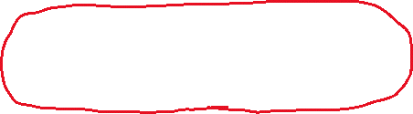
Encoder-decoder

Slide 36
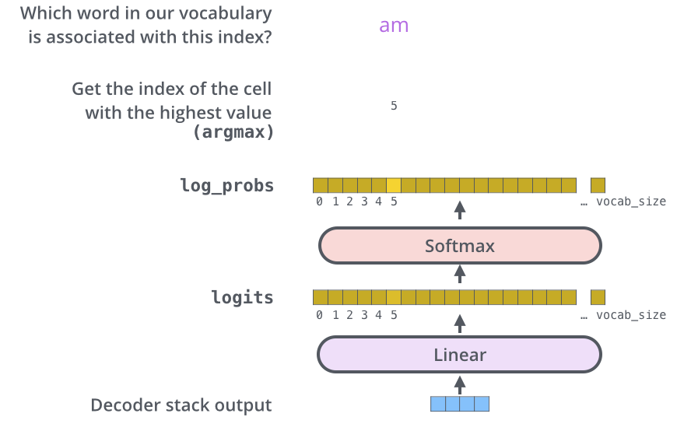
Decoder output layer

Slide 37
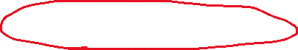
Encoder-decoder

Slide 38

Decoder

Slide 39

Decoder

Slide 40

Transformer
Many components!
Self-attention (NxN)
Multiple self-attention heads per layer
Multiple self-attention layers
Encoder + decoder
Worth it?

Slide 41
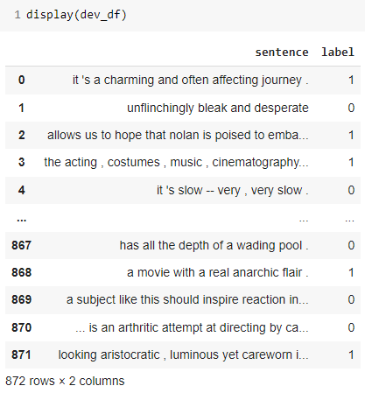
Reading SST-2

Slide 42
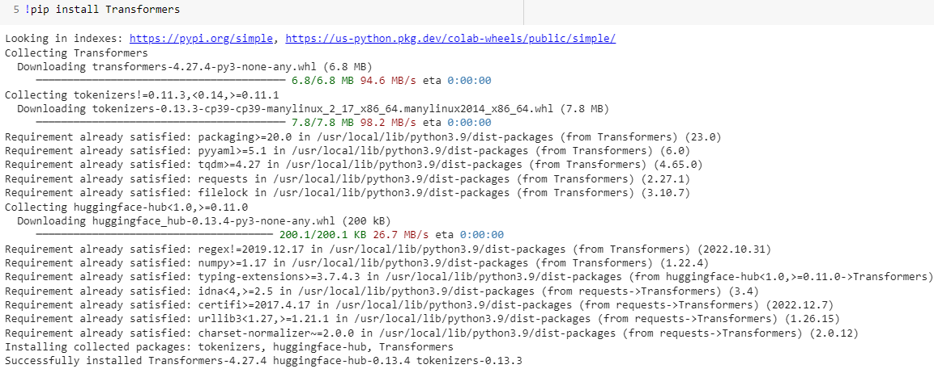
Installing Transformers

Slide 43
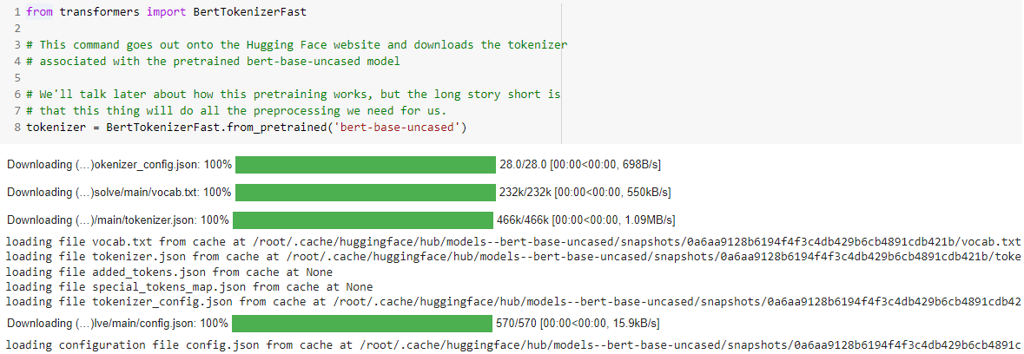
Transformer tokenizer

Slide 44
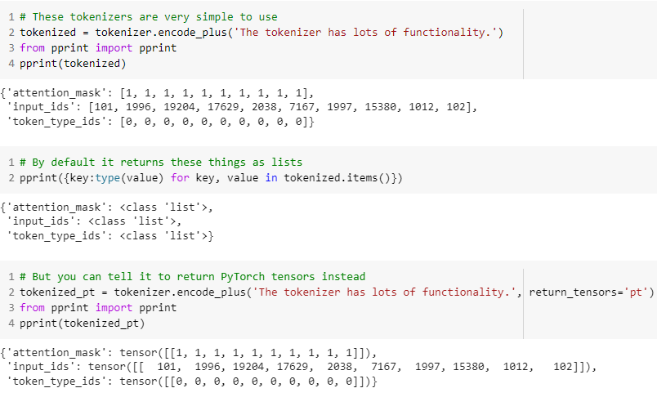
Transformer tokenizer

Slide 45
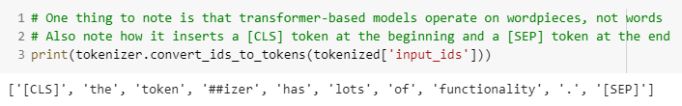
Transformer tokenizer

Slide 46
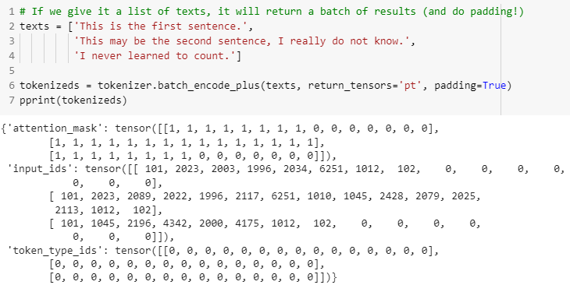
Transformer tokenizer

Slide 47
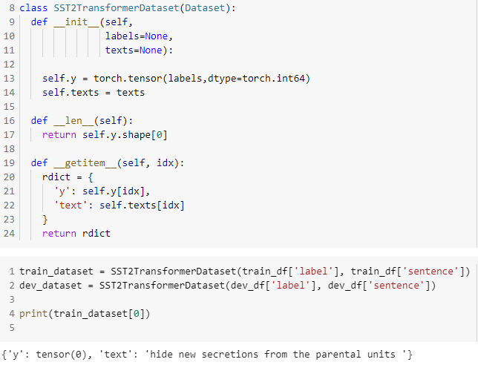
Dataset

Slide 48
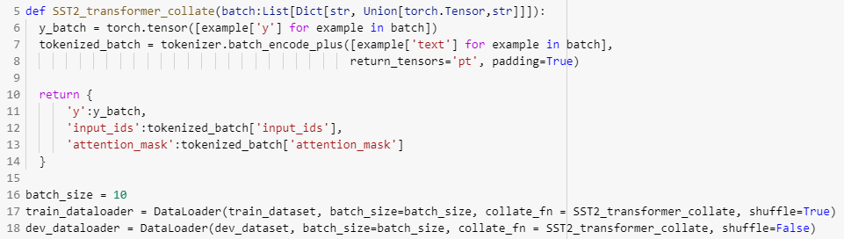
DataLoader

Slide 49
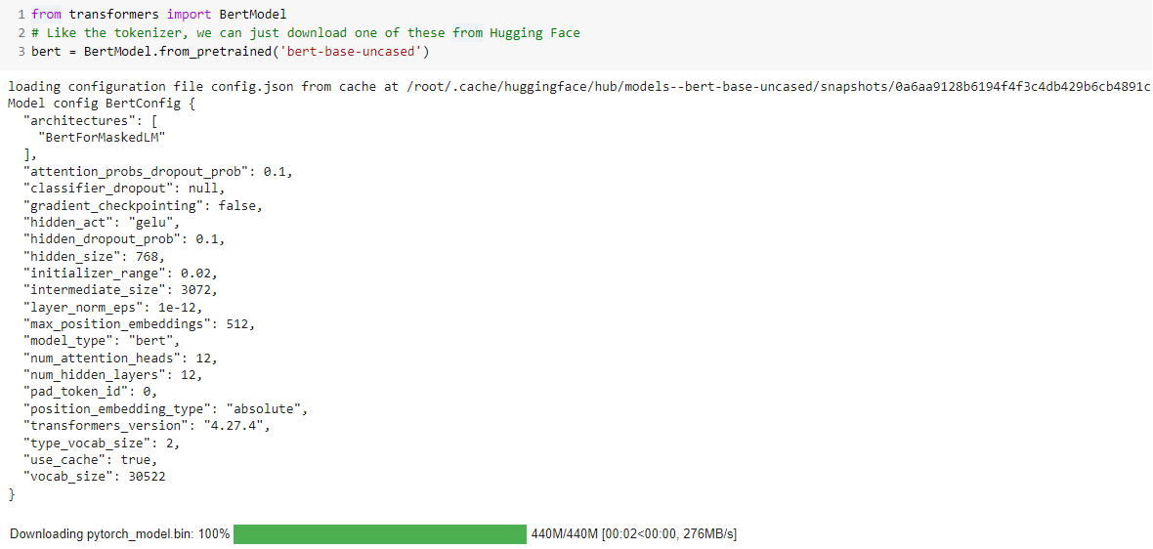
Pretrained transformers

Slide 50
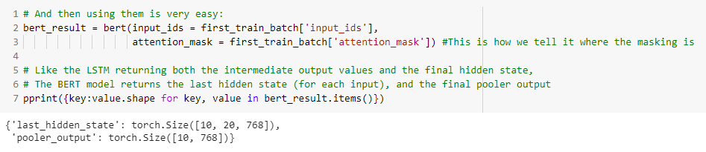
Pretrained Transformers

Slide 51
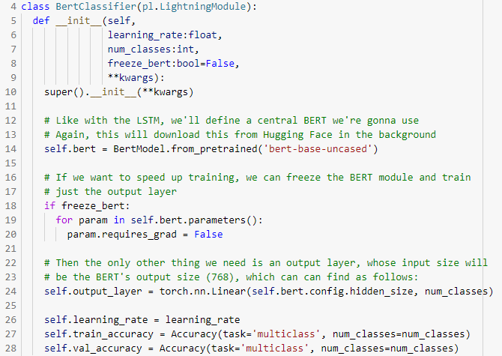
Transformer-using model

Slide 52
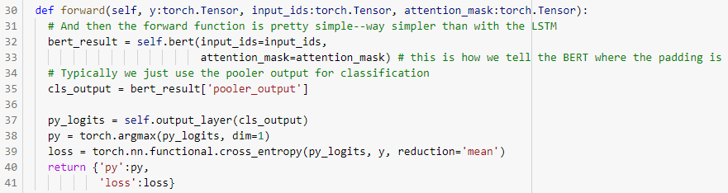
Transformer-using model

Slide 53
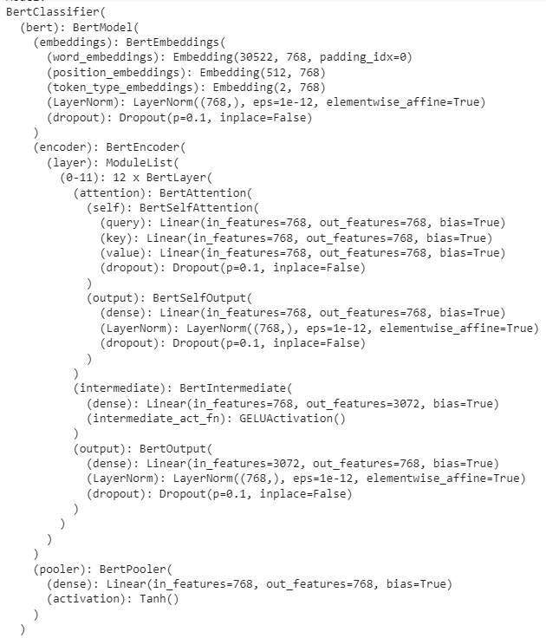
Transformer-using model

Slide 54
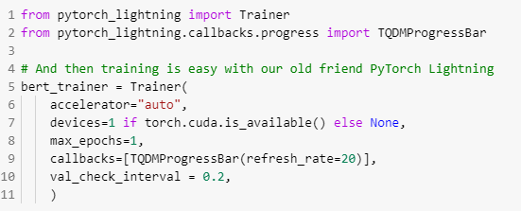
Training

Slide 55
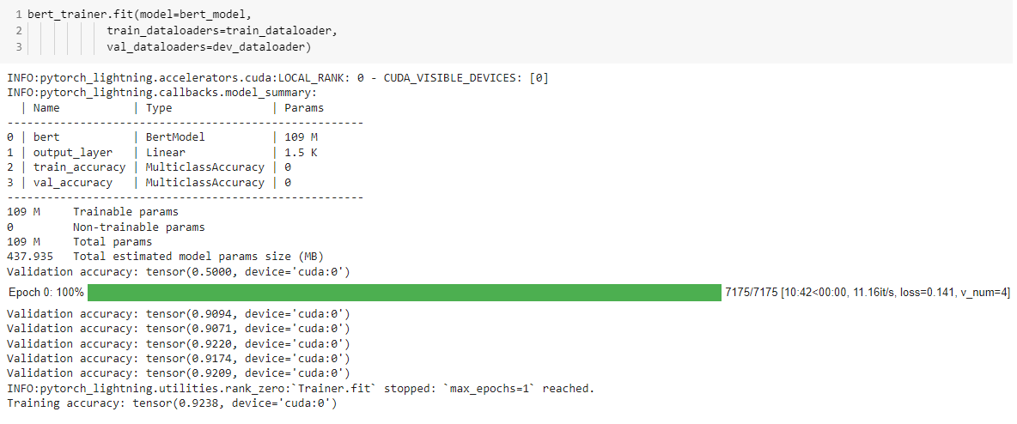
Training

